Slide 1
Sorting algorithms
Sorting is arranging data in ascending or descending order.
There are several type of sorting algorithms:
Insertion sort
Bubble sort
Selection sort
Shell sort
Quick sort

Slide 2
Correctness
An algorithm is correct with respect to a problem if
for every instance of the inputs (that is, the specified properties of the inputs are satisfied)
the algorithm halts, and
the outputs produced satisfy the specified input/output relation.
Correctness must be proven.
One counter-example is enough to disprove correctness, but (in general), no amount of testing can prove correctness.
Note that correctness of an algorithm doesn’t necessarily guarantee correctness of a program that claims to implement the algorithm.

Slide 3
Insertion sort
Insertion sort belongs to the O(n²) sorting algorithms. Unlike many sorting algorithms with quadratic complexity, it is actually applied in practice for sorting small arrays of data.
For instance, it is used to improve quick sort routine Some sources notice, that people use same algorithm ordering items, for example, hand of cards.

Slide 4
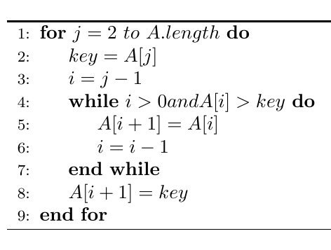
Insertion sort algorithm

Slide 5
Insertion Sort
values [ 0 ]
[ 1 ]
[ 2 ]
[ 3 ]
[ 4 ]
36
24
10
6
12
One by one, each as yet unsorted array element is inserted into its proper place with respect to the already sorted elements.
On each pass, this causes the number of already sorted elements to increase by one.

Slide 6
Insertion Sort
Works like someone who “inserts” one more card at a time into a hand of cards that are already sorted.
To insert 12, we need to make room for it by moving first 36 and then 24.
6
10
24
36
12

Slide 7
Insertion Sort
Works like someone who “inserts” one more card at a time into a hand of cards that are already sorted.
To insert 12, we need to make room for it by moving first 36 and then 24.
6
10
24
36
12

Slide 8
Insertion Sort
Works like someone who “inserts” one more card at a time into a hand of cards that are already sorted.
To insert 12, we need to make room for it by moving first 36 and then 24.
6
10
24
36
12

Slide 9
Insertion Sort
Works like someone who “inserts” one more card at a time into a hand of cards that are already sorted.
To insert 12, we need to make room for it by moving first 36 and then 24.
12
24
6
10
36

Slide 10
Insertion Sort: Pass One
values [ 0 ]
[ 1 ]
[ 2 ]
[ 3 ]
[ 4 ]
36
24
10
6
12
SORTED
U
N
S
O
R
T
E
D

Slide 11
Insertion Sort: Pass Two
values [ 0 ]
[ 1 ]
[ 2 ]
[ 3 ]
[ 4 ]
24
36
10
6
12
SORTED
U
N
S
O
R
T
E
D

Slide 12
Insertion Sort: Pass Three
values [ 0 ]
[ 1 ]
[ 2 ]
[ 3 ]
[ 4 ]
10
24
36
6
12
S
O
R
T
E
D
UNSORTED

Slide 13
Insertion Sort: Pass Four
values [ 0 ]
[ 1 ]
[ 2 ]
[ 3 ]
[ 4 ]
6
10
24
36
12
S
O
R
T
E
D
UNSORTED

Slide 14
Insertion Sort: Pass Five
values [ 0 ]
[ 1 ]
[ 2 ]
[ 3 ]
[ 4 ]
6
10
12
24
36
S
O
R
T
E
D

Slide 15
Complexity
Insertion sort's overall complexity is O(n²) on average, regardless of the method of insertion. On the almost sorted arrays insertion sort shows better performance, up to O(n) in case of applying insertion sort to a sorted array.
Number of writes is O(n²) on average, but number of comparisons may vary depending on the insertion algorithm. It is O(n²) when shifting or swapping methods are used and O(n log n) for binary insertion sort.
From the point of view of practical application, an average complexity of the insertion sort is not so important. As it was mentioned above, insertion sort is applied to quite small data sets (from 8 to 12 elements).
Therefore, first of all, a "practical performance" should be considered. In practice insertion sort outperforms most of the quadratic sorting algorithms, like selection sort or bubble sort.

Slide 16
Insertion Sort runtimes
Best case: O(n). It occurs when the data is in sorted order. After making one pass through the data and making no insertions, insertion sort exits.
Average case: θ(n^2) since there is a wide variation with the running time.
Worst case: O(n^2) if the numbers were sorted in reverse order.

Slide 17
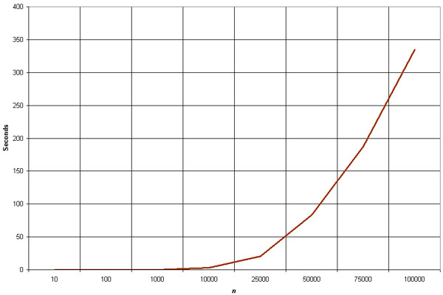
Empirical Analysis of Insertion Sort
The graph demonstrates the n^2 complexity of the insertion sort.
Source: http://linux.wku.edu/~lamonml/algor/sort/insertion.html

Slide 18
Bubble sort
inputs: array A of integers, of length n
outputs: ordered array A, with same elements as A0
for i ← 1 to n
for j ← n down to i + 1
if A[j ] < A[j − 1] then
swap A[j ] and A[j − 1]
We can assume the inputs satisfy the specification, i.e. that A is an array of integers and n is its length. Our array indexes count from 1, so the values are A[1], . . . ,A[n].

Slide 19
Bubble sort
Bubble sort is a simple and well-known sorting algorithm. It is used in practice once in a blue moon and its main application is to make an introduction to the sorting algorithms.
Bubble sort belongs to O(n²) sorting algorithms, which makes it quite inefficient for sorting large data volumes.
Bubble sort is stable and adaptive.

Slide 20
Algorithm
Compare each pair of adjacent elements from the beginning of an array and, if they are in reversed order, swap them.
If at least one swap has been done, repeat step 1.

Slide 21
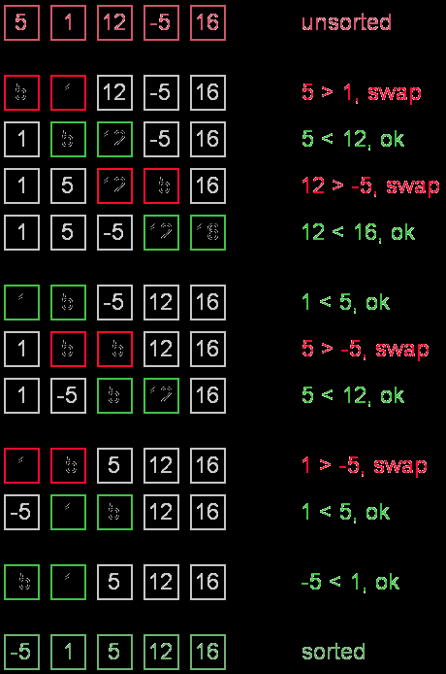
Example. Sort {5, 1, 12, -5, 16} using bubble sort.

Slide 22
Complexity
Average and worst case complexity of bubble sort is O(n²). Also, it makes O(n²) swaps in the worst case. Bubble sort is adaptive.
It means that for almost sorted array it gives O(n) estimation. Avoid implementations, which don't check if the array is already sorted on every step (any swaps made).
This check is necessary, in order to preserve adaptive property.

Slide 23
Selection sort
Selection sort is one of the O(n²) sorting algorithms, which makes it quite inefficient for sorting large data volumes.
Selection sort is notable for its programming simplicity and it can over perform other sorts in certain situations (see complexity analysis for more details).

Slide 24
Algorithm
The idea of algorithm is quite simple. Array is imaginary divided into two parts - sorted one and unsorted one.
At the beginning, sorted part is empty, while unsorted one contains whole array. At every step, algorithm finds minimal element in the unsorted part and adds it to the end of the sorted one. When unsorted part becomes empty, algorithm stops.
When algorithm sorts an array, it swaps first element of unsorted part with minimal element and then it is included to the sorted part.
This implementation of selection sort in not stable. In case of linked list is sorted, and, instead of swaps, minimal element is linked to the unsorted part, selection sort is stable.

Slide 25
Selection sort pseudocode
SELECTION-SORT(A) 1. for j ← 1 to n-1 2. smallest ← j 3. for i ← j + 1 to n 4. if A[ i ] < A[ smallest ] 5. smallest ← i 6. Exchange A[ j ] ↔ A[ smallest ]

Slide 26
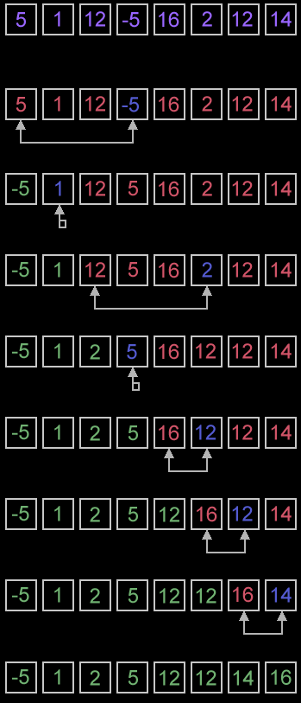
Example. Sort {5, 1, 12, -5, 16, 2, 12, 14} using selection sort.

Slide 27
Complexity analysis
Selection sort stops, when unsorted part becomes empty. As we know, on every step number of unsorted elements decreased by one.
Therefore, selection sort makes n steps (n is number of elements in array) of outer loop, before stop. Every step of outer loop requires finding minimum in unsorted part. Summing up, n + (n - 1) + (n - 2) + ... + 1, results in O(n²) number of comparisons.
Number of swaps may vary from zero (in case of sorted array) to n - 1 (in case array was sorted in reversed order), which results in O(n) number of swaps. Overall algorithm complexity is O(n²).
Fact, that selection sort requires n - 1 number of swaps at most, makes it very efficient in situations, when write operation is significantly more expensive, than read operation.

Slide 28
Quicksort
Quicksort is a fast sorting algorithm, which is used not only for educational purposes, but widely applied in practice.
On the average, it has O(n log n) complexity, making quicksort suitable for sorting big data volumes.
The idea of the algorithm is quite simple and once you realize it, you can write quicksort as fast as bubble sort.

Slide 29
Algorithm
The divide-and-conquer strategy is used in quicksort. Below the recursion step is described:
Choose a pivot value. We take the value of the middle element as pivot value, but it can be any value, which is in range of sorted values, even if it doesn't present in the array.
Partition. Rearrange elements in such a way, that all elements which are lesser than the pivot go to the left part of the array and all elements greater than the pivot, go to the right part of the array. Values equal to the pivot can stay in any part of the array. Notice, that array may be divided in non-equal parts.
Sort both parts. Apply quicksort algorithm recursively to the left and the right parts.

Slide 30
Quick sort pseudocode
Quicksort(A,p,r) {
if (p < r)
{
q <- Partition(A,p,r)
Quicksort(A,p,q)
Quicksort(A,q+1,r)
}
}

Slide 31
Partition
Partition(A,p,r)
x <- A[p]
i <- p-1
j <- r+1
while (True)
{ repeat j <- j-1 until (A[j] <= x)
repeat i <- i+1 until (A[i] >= x)
if (i<-="" a[i]="" exchange=""> A[j] else return(j) } }

Slide 32
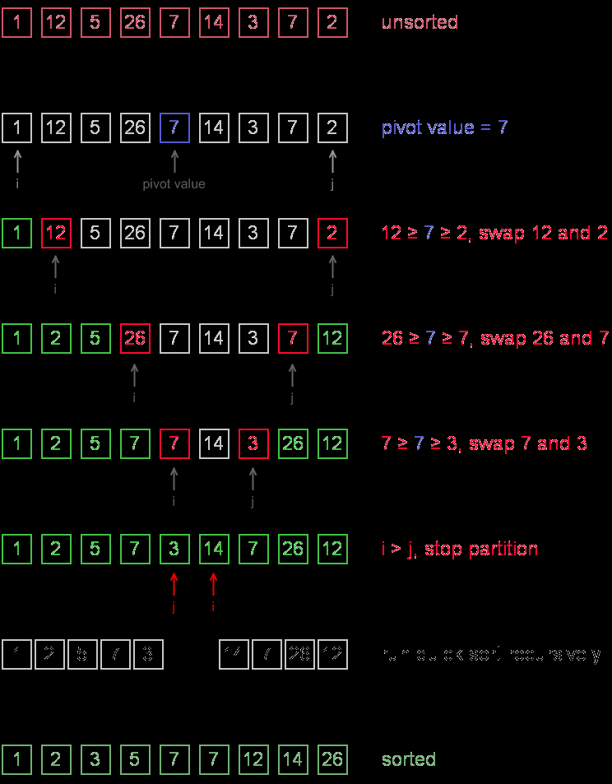
Example. Sort {1, 12, 5, 26, 7, 14, 3, 7, 2} using quicksort.

Slide 33
Complexity analysis
On the average quicksort has O(n log n) complexity, but strong proof of this fact is not trivial and not presented here.
Still, you can find the proof in [1]. In worst case, quicksort runs O(n²) time, but on the most "practical" data it works just fine and outperforms other O(n log n) sorting algorithms.

Slide 34
Shellsort
Founded by Donald Shell and named the sorting algorithm after himself in 1959.
1st algorithm to break the quadratic time barrier but few years later, a sub quadratic time bound was proven
Shellsort works by comparing elements that are distant rather than adjacent elements in an array or list where adjacent elements are compared.

Slide 35
Shellsort
Shellsort uses a sequence h₁, h₂, …, h_{t} called the increment sequence. Any increment sequence is fine as long as h₁ = 1 and some other choices are better than others.

Slide 36
Shellsort
Shellsort makes multiple passes through a list and sorts a number of equally sized sets using the insertion sort.

Slide 37
Shellsort
Shellsort improves on the efficiency of insertion sort by quickly shifting values to their destination.

Slide 38
Shellsort
Shellsort is also known as diminishing increment sort.
The distance between comparisons decreases as the sorting algorithm runs until the last phase in which adjacent elements are compared

Slide 39
Shellsort
After each phase and some increment h_{k}, for every i, we have a[ i ] ≤ a [ i + h_{k} ] all elements spaced h_{k} apart are sorted.
The file is said to be h_{k} – sorted.

Slide 40
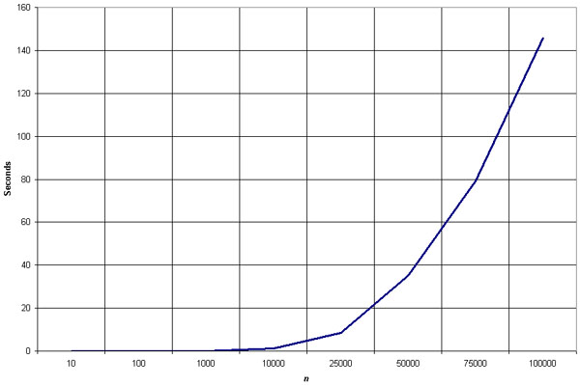
Empirical Analysis of Shellsort
Source: http://linux.wku.edu/~lamonml/algor/sort/shell.html

Slide 41
Shell sort algorithm
SHELL-SORT(A,n)
// we take gap sequence in order of |N/2|, |N/4|, |N/8|...1
for gap=n/2; gap=0; gap/=2 do:
//Perform gapped insertion sort for this gap size.
for i=gap; i<n; i+=1 do: temp=A[i]
// shift earlier gap-sorted elements up until
// the correct location for a[i] is found
for j=i; j>=gap && A[j-gap]>temp;j-=gap
do:
A[j]= A[j-gap]
end for
// put temp in its correct location
A[j]= temp;
end for
end for
end func

Slide 42
Empirical Analysis of Shellsort (Advantage)
Advantage of Shellsort is that its only efficient for medium size lists. For bigger lists, the algorithm is not the best choice. Fastest of all O(N^2) sorting algorithms.
5 times faster than the bubble sort and a little over twice as fast as the insertion sort, its closest competitor.

Slide 43
Empirical Analysis of Shellsort (Disadvantage)
Disadvantage of Shellsort is that it is a complex algorithm and its not nearly as efficient as the merge, heap, and quick sorts.
The shell sort is still significantly slower than the merge, heap, and quick sorts, but its relatively simple algorithm makes it a good choice for sorting lists of less than 5000 items unless speed important. It's also an excellent choice for repetitive sorting of smaller lists.

Slide 44
Shellsort Best Case
Best Case: The best case in the shell sort is when the array is already sorted in the right order. The number of comparisons is less.

Slide 45
Shellsort Worst Case
The running time of Shellsort depends on the choice of increment sequence.
The problem with Shell’s increments is that pairs of increments are not necessarily relatively prime and smaller increments can have little effect.

Slide 46
Shellsort Examples
Sort: 18 32 12 5 38 33 16 2
8 Numbers to be sorted, Shell’s increment will be floor(n/2)
* floor(8/2) ➔ floor(4) = 4
increment 4:
1 2 3 4
(visualize underlining)
18 32 12 5 38 33 16 2
Step 1) Only look at 18 and 38 and sort in order ;
18 and 38 stays at its current position because they are in order.
Step 2) Only look at 32 and 33 and sort in order ;
32 and 33 stays at its current position because they are in order.
Step 3) Only look at 12 and 16 and sort in order ;
12 and 16 stays at its current position because they are in order.
Step 4) Only look at 5 and 2 and sort in order ;
2 and 5 need to be switched to be in order.

Slide 47
Shellsort Examples (con’t)
Sort: 18 32 12 5 38 33 16 2
Resulting numbers after increment 4 pass:
18 32 12 2 38 33 16 5
* floor(4/2) ➔ floor(2) = 2
increment 2:
1 2
18 32 12 2 38 33 16 5
Step 1) Look at 18, 12, 38, 16 and sort them in their appropriate location:
12 38 16 2 18 33 38 5
Step 2) Look at 32, 2, 33, 5 and sort them in their appropriate location:
12 2 16 5 18 32 38 33

Slide 48
Shellsort Examples (con’t)
Sort: 18 32 12 5 38 33 16 2
* floor(2/2) ➔ floor(1) = 1
increment 1:
1
12 2 16 5 18 32 38 33
2 5 12 16 18 32 33 38
The last increment or phase of Shellsort is basically an Insertion
Sort algorithm.

Slide 49
The end

